Slide 1



Embedded Systems: Timers

Slide 2
Today
Timer block diagram
Which timer to choose?
Typical applications
Configurations
Timer interrupt code example
Challenge

Slide 3
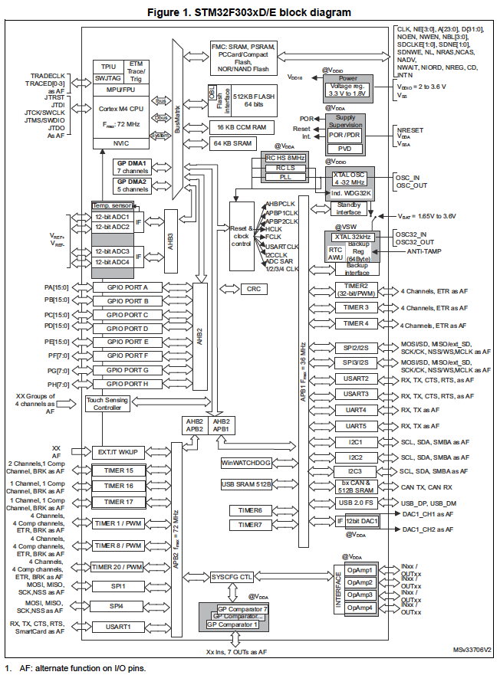
Timers - overview
Notes:
Block diagram is of STM32F303xD/E MCU

Slide 4
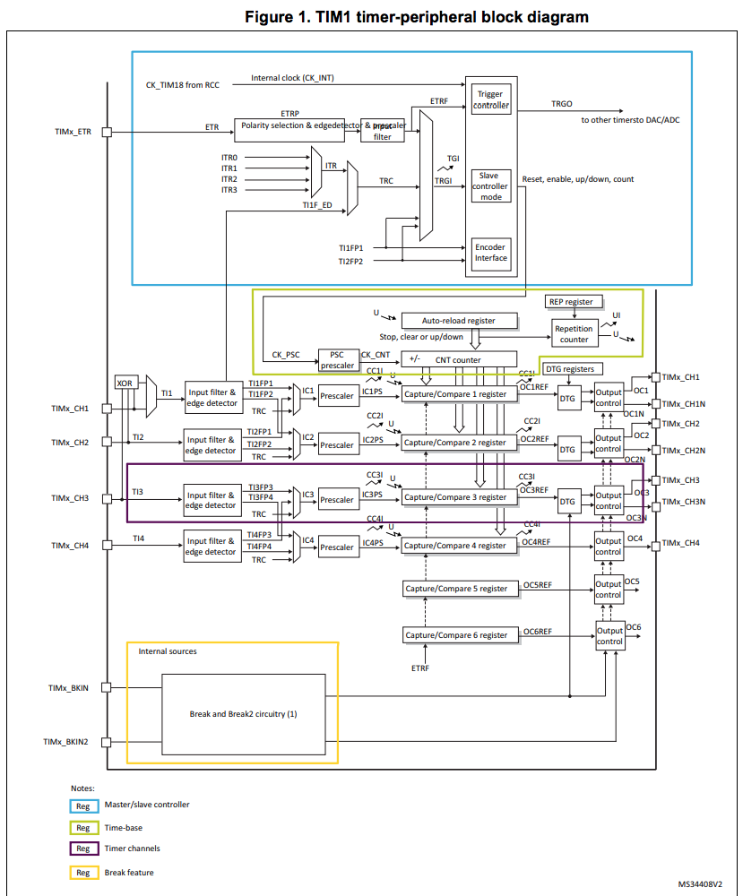
Timers - block diagram

Slide 5
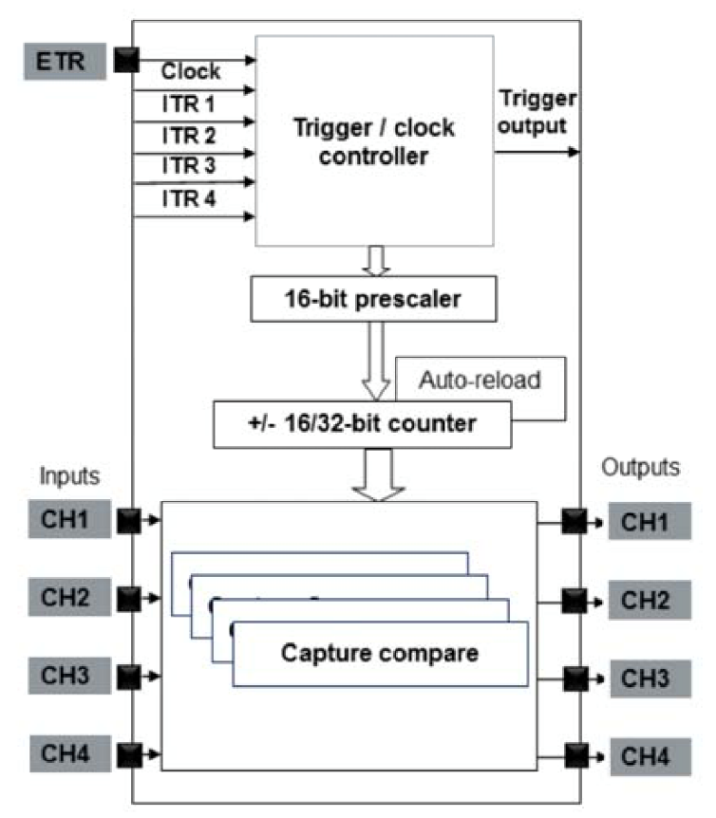
Timers - simplified block diagram
Notes:
The STM32 timers are very versatile and provide multiple operation modes to off-load the CPU from repetitive and time critical tasks.
Upper half of the picture:
Central to the timer structure is the 16 or 32 bit counter. This counter counts a clock signal. This can be the internal clock, a clock coming from another timer (ITRx) or an external clock (ETR). The clock signal is first going through a prescaler before it is fed to the counter.
Lower half of the picture:
There are four capture/compare registers. The counter value can be compared with register values and on a match an output signal can be set and an interrupt can be generated. There are four ‘channels’, each has a comparator. This means there are also 4 output channels, TIMx_CH1…TIMx_CH4. This can be used for example to generate PWM output.
In addition there are also 4 input channels with edge detection which can trigger actions like capturing the counter value. This can be used for example to measure the duration of a pulse or measure PWM input.

Slide 6
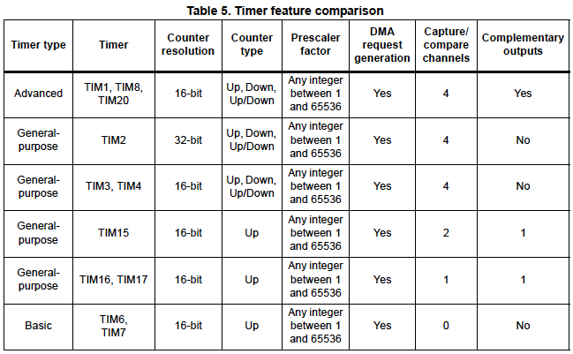
Timers – which one to choose? Timers in the M32F303xD/E MCU
Note
In this course we use the General-purpose timers TIM2/TIM3/TIM4, other timers can behave differently!
Question:
What is the maximum count value of a 16 bit timer?
Notes:
This presentation is based on the General-purpose timers TIM2/TIM3/TIM4. Other timers can behave differently.
For example Advanced-control TIM1 and also TIM15/TIM16/TIM17 contain a break circuit for output protection. This means additional code is needed to enable the capture compare output:
TIMx->BDTR |= TIM_BDTR_MOE; // Main output enable. Otherwise output OC1 will remain low.
Next to the timers shown the STM32F303xD/E also contains two watchdog timers and one SysTick timer.
The SysTick timer is a 24-bit down counter and is dedicated for real time operating systems. This is the reason that when FreeRTOS is included, the HAL timebase should be set to a different timer so it does not interfere with FreeRTOS.

Slide 7
Application: Timebase Upcounting mode with auto reload
ARR
Configuration
Enable timer clock in RCC_APB1ENR or RCC_APB2ENR register.
Set prescaler register (TIMx_PSC) to scale down the timer clock.
Set TIMx_ARR to determine the upper count.
Enable Interrupt Vector with ﻿NVIC_EnableIRQ().
Enable timer update interrupt (UIE flag in TIMx_DIER).
Enable counter (TIMx_CR1).
CNT
Update interrupt
Update interrupt
Notes
Can be used to create a timebase.
The timer clock is equal to SystemCoreClock / (prescaler + 1)
When ARR is reached an interrupt will be generated when enabled.
Notes:
Some notes:
To enable the timer clock one can set the appropriate bit in RCC_APB1ENR or RCC_APB2ENR. Note that TIM2/TIM3/TIM4 are in RCC_APB1ENR. In code this register can be accessed with RCC->APB1ENR.
Because we use the Update interrupt in this mode, be sure in the timer interrupt handler to reset the Update interrupt flag UIF, located in TIMx_SR. Otherwise the interrupt will occur again!
The interrupt flag in the TIMx_SR register is reset by writing a ‘0’ to the corresponding pending bit. In the reference manual this can be seen because it is a so-called rc-w0 bit: ‘Software can read as well as clear this bit by writing ‘0’. Writing ‘1’ has no effect on the bit value.’
Resetting the interrupt flag in this case can be done using TIMx->SR = ~TIM_SR_UIF. Note that a bitwise AND operation is not needed as writing a ‘1’ for the other interrupt flags has no effect on the bit value.
The following is hard to extract from the data sheet and is only needed if you have trouble with the first timer interrupt occurring too soon. In most cases you can forget about this. It may happen that right after enabling the counter the timer interrupt handler is called. This happens because normally the new prescaler value is loaded only after an update event which occurs after the first interrupt. So until then the default prescaler value is used which is 0 (which means effectively a prescaler of 1). This will cause the first interrupt to occur too soon. It can be prevented by adding the two lines of code below right after setting the prescaler register. This is hard to extract from the data sheet and we do not expect this from students. TIM2->EGR |= TIM_EGR_UG; // Set the UG (Update Event Generator) bit which forces the new prescaler value to be loaded. TIM2->SR = ~TIM_SR_UIF; // Reset the Update Interrupt flag to prevent the IRQ handler to be called after enabling the counter.

Slide 8
Application: Counting pulses Upcounting mode with external clock
timer channel 1 input (external clock)
Configuration
Enable timer clock in RCC_APB1ENR or RCC_APB2ENR register.
Set prescaler register (TIMx_PSC) if required to scale down the external clock.
Set external clock mode 2 (TIMx_SMCR).
Enable counter (TIMx_CR1).
Connect a GPIO pin to the timer external clock input TIMx_ETR input by setting an alternate function for that pin, see later in this presentation.
CNT
Notes
Can be used to count pulses of an external signal. Combining this with a timebase one can determine the frequency or period of an external signal.
A GPIO pin can be connected to the timer channel 1 input using the appropriate alternate function for that pin.

Slide 9
Application: PWM output Capture compare mode – PWM mode 1
ARR
Configuration
Enable timer clock in RCC_APB1ENR or RCC_APB2ENR register.
Set prescaler register (TIMx_PSC) to scale down the timer clock.
Set upper count (TIMx_ARR).
Set CC1 channel as output (TIMx_CCMR1).
Set PWM mode 1 (TIMx_CCMR1).
Set Capture/Compare count at which output should go from high to low (TIMx_CCRx).
Enable Capture/Compare output (TIMx_CCER).
Enable counter (TIMx_CR1).
Connect timer channel 1 output to a GPIO pin by setting an alternate function for that pin, see later in this presentation.
CCR1
CNT
timer channel 1 output
Notes
Can be used to control a servo.
The timer channel 1 output can be connected to a GPIO pin using the appropriate alternate function for that pin. This way for example a servo can be connected.
Notes:
Some notes:
PWM mode 2 will have the inverted output with respect to PMW mode 1.
If desired it is possible to have an Capture compare interrupt at the moment the counter reaches CCR1 by enabling the CC1IE flag in the TIMx_DIER register. PWM mode 1 does not have to be set if only the interrupt is required and not the channel output.
When a Capture compare interrupt is used, be sure in the timer interrupt handler to reset the Capture compare interrupt flag CC1IF, located in TIMx_SR. Otherwise the interrupt will occur again!

Slide 10
Application: PWM input PWM input mode
Configuration (see also the example in the reference manual)
Enable timer clock in RCC_APB1ENR or RCC_APB2ENR register.
Set prescaler register (TIMx_PSC) to scale down the timer clock to 1 MHz.
Set CC1 channel as input with IC1 mapped on TI1 (TIMx_CCMR1, CC1S bits on ‘01’).
Set CC1NP/CC1P bits to noninverted / rising edge (TIMx_CCER, CC1NP bit on ‘0’, CC1P bit on ‘0’).
Enable Capture/Compare 1 capture (TIMx_CCER, CC1E bit on ‘1’).
Set CC2 channel as input with IC2 mapped on TI1 (TIMx_CCMR1 CC2S bits on ’10’).
Set CC2NP/CC2P bits to inverted / falling edge (TIMx_CCER, CC2NP bit on ‘0’, CC2P bit on ‘1’).
Enable Capture/Compare 2 capture (TIMx_CCER, CC2E bit on ‘1’).
Set Trigger selection to Filtered Timer Input 1 (TIMx_SMCR, TS bits on ‘101’).
Set Slave mode selection to Reset Mode (TIMx_SMCR, SMS[2:0] bits on ‘100’).
Enable counter (TIMx_CR1).
Connect timer channel 1 input to a GPIO pin by setting an alternate function for that pin, see later in this presentation.
PWM input signal
reset counter
pulse width in TIMx_CCR2 register
period in TIMx_CCR1 register
Notes
Powerful mode, no CPU resources / interrupts!
Can be used to measure the PWM feedback signal of a servo like the Parallax Feedback 360° High-Speed Servo.
The PWM input mode is a complex mode. See the Speaker Notes for a short explanation.
When the prescaler is configured such that the timer clock is scaled down to 1 MHz, the pulse width read from the TIMx_CCR2 register will be in µs.
Make sure to use a timer which supports PWM input mode!
Notes:
Some notes:
The recipe for this mode is rather complicated. Therefore the bits to be set in each register are mentioned.
The Parallax Feedback 360° High-Speed Servo will return a PWM like signal, see the datasheet in the Toolbox section of the Canvas course.
According to the Parallax Feedback 360° High-Speed Servo data sheet the pulse width will vary from appr. 2.9% to 91.7% of 1.1 ms being 32 µs to 1009 µs.
On the NUCLEO-F303RE board general purpose timers TIM2/TIM3/TIM4 do support PWM input mode, while for example TIM16 and TIM17 do not.
PWM input mode in short (see also the description in the reference manual): In the PWM input mode two capture channels are used: - The CC1 channel is used to capture the timer count at the rising edge in TIMx_CCR1 and reset the counter. - The CC2 channel is used to capture timer count at the falling edge in TIMx_CCR2. The result is that the pulse width is available in TIMx_CCR2 and the period in TIMx_CCR1. The physical PWM input signal is connected to TIMx_CH1 by setting the appropriate alternate function. The TIMx_CH1 input is then connected to CC1 and CC2 by setting the appropriate bits in the TIMx_CCMR1 register.
It is best to leave TIMx_ARR at its default maximum value so the counter will not be reloaded prematurely. In PWM input mode the reload and update of the CCR* registers is done at the end of the PWM period by setting the Reset mode in TIMx_SMCR.
An alternative to the PWM input mode is to use a timer and interrupts. This can be done by having an interrupt signal on the rising and falling edges of the PWM input signal. On the rising edge one can reset the timer count and on the falling edge one can read the timer count value representing the pulse width. Disadvantage of this method is that the interrupts will use CPU resources and the result might not be as accurate, especially when other interrupts are also running.
And last but not least:
When PWM input mode does not seem to work, finding the cause is often challenging. The problem can be in the wiring, alternate function setting or timer register settings. In this case check the TIMx_CNT register by printing out the value or using the debugger. There you can see if the timer is counting or not. If the timer is counting, then probably something is wrong with the wiring or alternate function settings. If the timer is not counting, then probably the problem is in the timer register settings.

Slide 11
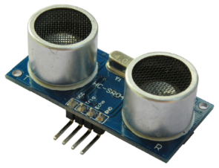
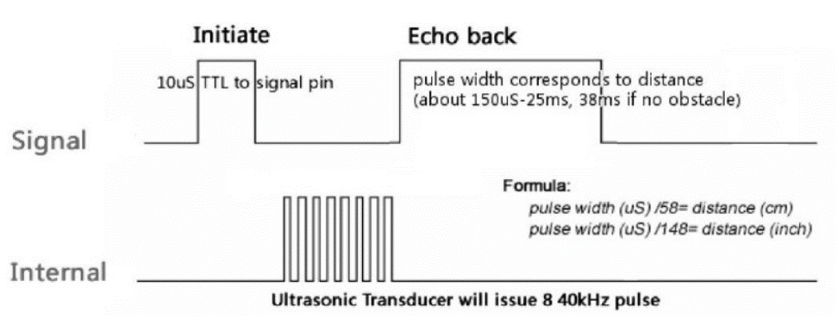
Example: PWM output + PWM input to read out ultrasonic sensor HC-SR04
Fact:
Sound travels appr. 34 cm/ms
Trigger (Initiate) signal = PWM output signal
10 μs trigger pulse
20..100 ms between trigger pulses to make sure there is no more echo (for distances < 1m 20 ms is ok)
Echo signal = PWM input signal
Appr. 150 μs … 25 ms or 2.5 cm … 425 cm
Note: The distance can simply be read out of register CCR2 of the PWM input timer. No further CPU resources or interrupts needed, much better than the Arduino PulseIn function!
Very important note:
When connecting the ultrasonic sensor HC-SR04 to an STM32 board, make sure you connect the echo output pin to a 5V tolerant input pin on the STM32 board!
Notes:
Notes:
Reading the HC-SR04 with a timer is much better than the method the Arduino PulseIn function uses. PulseIn uses an assembler coded loop with fixed timing to measure the echo pulse width. This is blocking and interrupts will disrupt the measurement, see https://www.best-microcontroller-projects.com/arduino-pulsein.html.
The SMM32 NUCLEO board is a 3V3 board, but it contains a 5V connection pin. The HC-SR04 is connected to the 5V pin of the STM32 board, but the echo output signal must be connected to a 5V tolerant input pin of the STM32 board.
Which pins are 5V tolerant can be found in the device datasheet in the ‘pin definitions’ table. Take one which can also be attached to a channel input of an available timer which can do the PWM input.
Tips:
Set the PWM input prescaler to 72-1 so the echo pulse is measured in μs.
Set the PWM output prescaler to 720-1 so we count per 10 μs. This means 10 μs will be a count of 1 and 100ms will be a count of 10000 which still fits in a 16 bits register.
For better distance control performance you can take 20 ms for the PWM output period for an application with a 20 ms PID control loop. This will work well with distances < 1m.

Slide 12
Other applications of timers (let this inspire you!)
Encoder interface mode Measuring the rotation of a (quadrature) motor encoder or manual rotary encoder. See the recipe in the reference manual. This mode can deal with jitter / bouncing of the encoder!
Gated mode External pulses can be counted during a specified ‘gate’ time. This way it is possible to measure frequency after configuration of the timers without the need for interrupts or additional code! This means high frequencies can be measured.
...

Slide 13
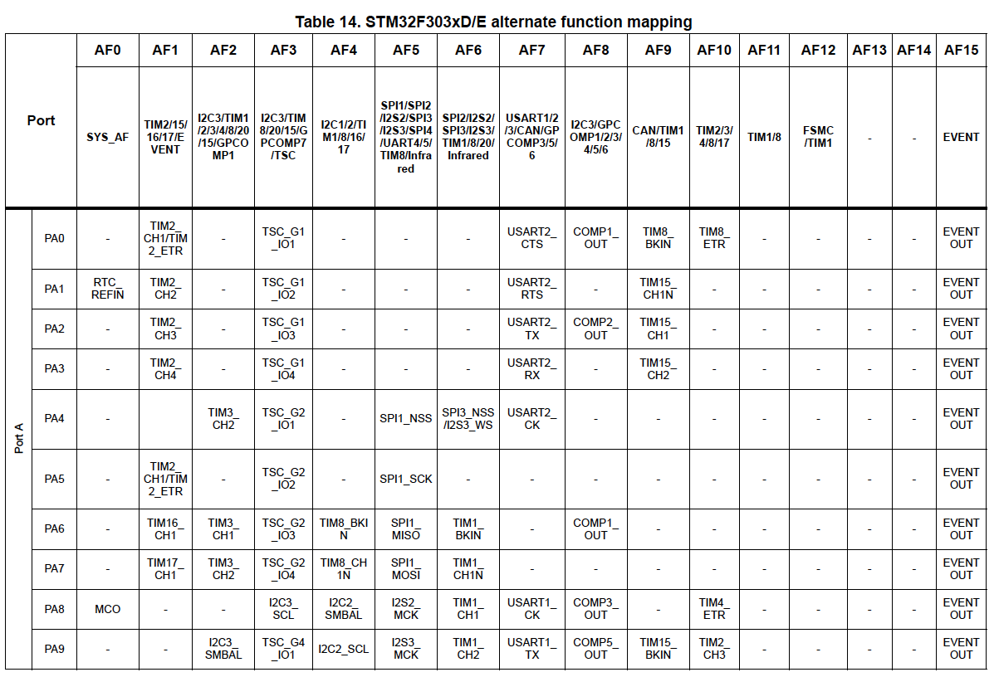
Setting alternate function See alternate function mapping table in device data sheet
Suppose we want to connect GPIO pin PA2 to internal USART2_TX
(just as an example) This means we have to:
set GPIO pin PA2 to alternate function
Select alternate function AF7 for this pin
Notes:
In this example the capture/compare interrupt of timer 1 is enabled. This can be used to generate an interrupt when the timer reaches a specific value specified in one of the four capture/compare registers, specified by ‘*’ in the example code.
WATCH OUT: some pins are already occupied. On the NUCLEO-F303RE board for example pin PA2 and PA3 are already programmed to connect to USART_TX and USART_RX respectively.
In STM32CubeMX one can see which pins are already occupied.

Slide 14
Setting alternate function code example
Connect GPIO pin PA2 to internal USART2_TX
// Set GPIO pin PA2 to alternate function.
GPIOA->MODER = (GPIOA->MODER & ~GPIO_MODER_MODER2) | (0b10 << GPIO_MODER_MODER2_Pos);
// Select alternate function AF7 (USART2_TX) for GPIO pin PA2.
GPIOA->AFR[0] = (GPIOA->AFR[0] & ~GPIO_AFRL_AFRL2) | (0b0111 << GPIO_AFRL_AFRL2_Pos);
Notes:
GPIOx_AFRL and GPIOx_AFRH in the datasheet map to GPIOx->AFR[0] and GPIOx->AFR[1] respectively in the code.

Slide 15
Timer interrupt code example Generate interrupt when timer reaches a specific value (capture/compare)
Definition of timer 2/3/4 capture/compare interrupt handler
extern "C" void TIM*_IRQHandler(void) // Do not forget the ‘extern “C”’ in case of C++
{
TIM*->SR = ~TIM_SR_CC*IF; // Reset capture/compare * interrupt flag. // This is needed otherwise the // interrupt handler will be called again.
// handle interrupt here
}
Enabling timer 2/3/4 capture/compare interrupt
NVIC_EnableIRQ(TIM*_IRQn); // Enable interrupt vector
TIM*->DIER |= TIM_DIER_CC*IE; // Capture/compare * interrupt enable
Notes:
For * fill in the right values, see reference manual.
NVIC_EnableIRQ() is a CMSIS function.
Notes:
In this example the capture/compare interrupt of timer 1 is enabled. This can be used to generate an interrupt when the timer reaches a specific value specified in one of the four capture/compare registers, specified by ‘*’ in the example code.
Notes:
This code example is for the capture/compare mode and not for the upcounting mode with auto reload mode (timebase). It serves just as an example and is not complete.
The interrupt flag in the TIMx_SR register is reset by writing a ‘0’ to the corresponding pending bit. In the reference manual this can be seen because it is a so-called rc-w0 bit: ‘Software can read as well as clear this bit by writing 0. Writing ‘1’ has no effect on the bit value.’
Resetting an interrupt flag can be done using TIM*->SR = ~TIM_SR_CC*IF. Note that a bitwise AND operation is not needed as writing a ‘1’ for the other interrupt flags has no effect on the bit value.

Slide 16
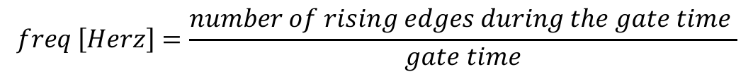
Challenge: How to measure the frequency of a signal?
signal to measure
gate signal
gate time
$$freq \left[Herz\right]=\frac{number of rising edges during the gate time }{gate time}$$
Notes:
To measure the frequency of a signal one can measure the number of rising edges during a time window, the so called ‘gate time’. To obtain enough precision the gate time has to be much larger than the period of the signal to measure.
Discuss in class:
What kind of timer(s) configuration(s) discussed in this presentation you could use to measure the frequency of an externally applied signal?
What is the influence of the gate time on the precision?
Note that there are multiple configurations possible with different precisions.
This discussion is input for the assignment of this module.
Important Note: In the assignment you will have to program your own timer(s), so do not make use of the System tick (SysTick) timer. This timer is only used to provide a system time tick of typically 1 ms.

Slide 17
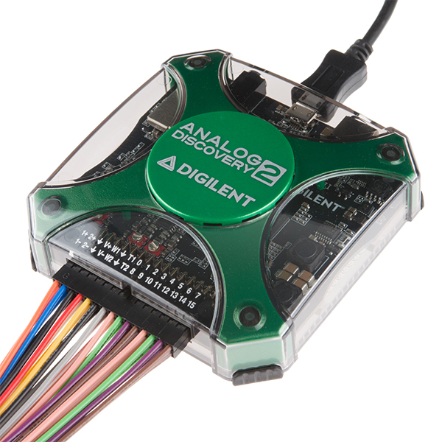
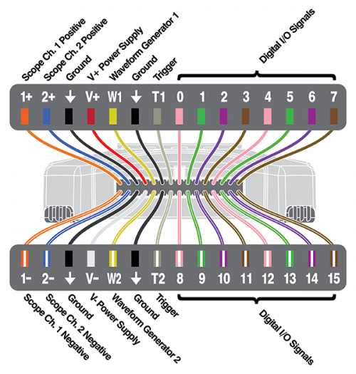
Analog Discovery 2 Use it to measure and to generate test signals!
https://reference.digilentinc.com/learn/instrumentation/tutorials/analog-discovery-2-getting-started
Also check out the YouTube Analog Discovery 2 Quick-Start videos!
Notes:
Discuss in Class:
Why are the signal lines on the Analog Discovery 2 differential (using equal but opposite voltages to ground on each of the two wires)?
How would you connect the wires for measuring a signal from and for generating a signal to the STM32 board?
From https://reference.digilentinc.com/learn/instrumentation/tutorials/ad2-oscilloscope/start:
Because the oscilloscope channels on the Analog Discovery 2 are fully differential, meaning that they can measure differences in potential between the “1+” and “1-” pins with no need for a GND reference, there is no need to connect a GND wire from the Analog Discovery 2, though you may if you wish.
Text from the assignment:
Important Note: The Analog Discovery 2 uses differential signals. This means a generated waveform will typically be symmetrical around the 0 V. On the other hand the STM32 boards have 3.3 V I/O pins, accepting only voltages between 0 and 3.3 V. Please make sure that the generated waveform is between 0 and 3.3 V. For the Analog Discovery 2 you can accomplish this by setting both wave generator amplitude and offset to 1.5 V. Neglecting this can ruin the board!

Slide 18
References
https://deepbluembedded.com/stm32-arm-programming-tutorials/
https://embedded-lab.com/blog/stm32-tutorials/
https://www.keil.com/pack/doc/CMSIS/General/html/index.html
https://community.arm.com/arm-community-blogs/b/architectures-and-processors-blog/posts/how-much-stack-memory-do-i-need-for-my-arm-cortex--m-applications

